Slide 1
Lecture 11
Introduction to Flask

Slide 2




Map
Getting Started
Front End
Back End
Advanced Topics
Introduction
Fundamentals
Git
Command Line
HTML
CSS
Responsive Design
JavaScript & jQuery
Web Frameworks
Architecture
Database Design
APIs
Visualization
Security
Deployment
Notes:
This is the course map for IOLab 2016
We have packaged the course in f
Open up netflix and utube
our modules

Slide 3
Map
Getting Started
Front End
Back End
Advanced Topics
Introduction
Fundamentals
Git
Command Line
HTML
CSS
Responsive Design
JavaScript & jQuery
Web Frameworks
Architecture
Database Design
APIs
Visualization
Security
Deployment
Notes:
This is the course map for IOLab 2016
We have packaged the course in four modules

Slide 4
Today
Preview – what lies ahead
Flask
Lab

Slide 5
Preview
This Week – FLASK (intro and deep dive)
Next week – Databases – intro , Databases/ORMs in Flask
March 9 – Project Presentations #1
Ideas, project plan and front end mockups
March 11 – NoSql and MongoDB hands on
March 16,18 Wrap up – Integrating back-end and front end plus more hands on
Beyond Spring break – module 4 – APIs, deployment etc

Slide 6
From Client Side to Server-Side

Slide 7
Client requests & Server responds
Client requests for resources
Server receives the request
Server inspects the request and parses out the URL
Works to get the right page/file/script
Maintains sessions when needed
Returns resources packed in an HTTP response

Slide 8
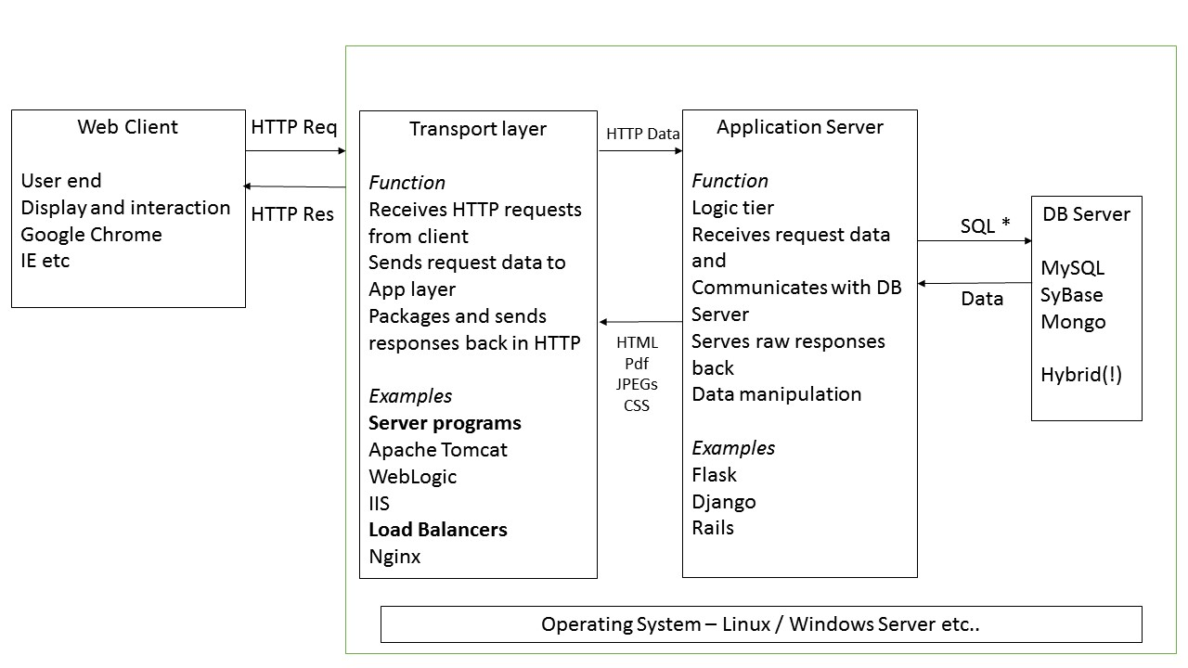
Web Server
App Server
FLASK
Client Side
Server Side
Notes:
Three servers here

Slide 9
Application Server
Web Server
DB Server
Controller Layer
View Layer
Model Layer
Notes:
This is where your framework sits – App server
You guys coded static view layer-views that never change
Some frameworks come packaged with everything – a model layer

Slide 10
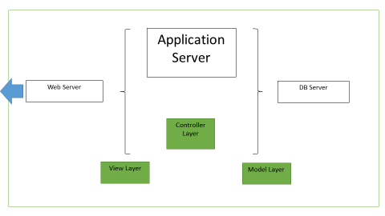
Full stack vs non-full stack framework
Some Frameworks come with all of these packaged
A storage mechanism (Model Layer)
A template engine (View Layer)
A web server
The Others come minimal
Bare application server
You can extend them

Slide 11

Flask is a minimalistic framework
Doesn’t include everything
Build it fast, perfect it later
It doesn’t mean that Flask lacks in functionality
Extensible libraries, plugin when you need
“The idea of Flask is to build a good foundation for all applications. Everything else is up to you or extensions.” –Official Docs

Slide 12
Why Flask
Easy to setup – just what you need
Can build apps really fast
Comes with a development-level web server
Huge community support (>Django)

Slide 13
Extend what you need
pip install flask-login
pip install flask-mail
pip install flask-sqlalchemy
pip install sqlalchemy-migrate
pip install flask-wtf
http://flask.pocoo.org/extensions/

Slide 14
Flask Structure
Directories, Subdirectories and key files

Slide 15
Application Server
Web Server
DB Server
Controller Layer
View Layer
Model Layer
Notes:
This is where your framework sits – App server
You guys coded static view layer-views that never change
Some frameworks come packaged with everything – a model layer

Slide 16
Application Server
WSGI
Web Server
DB Server
Controller Layer
View Layer
Model Layer
Notes:
Flask is the app server..lets say you create a web server that talks to the outside world
How does the app server talk to the web server?
You need an interface that allows this
Its called the web server gateway interface

Slide 17
Directories
Main application directory where the app server runs
Outside directory which allows web server to talk with it [WSGI]

Slide 18
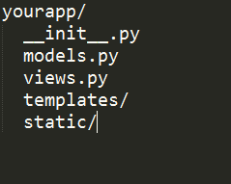
Directories
Main application directory where the app server runs

Slide 19
Directories
Main application directory where the app server runs
“STATIC” Folder
CSS , JS Files, Images, PDFs …

Slide 20
Directories
Main application directory where the app server runs
“Templates” Folder
All those HTML files you created ..

Slide 21
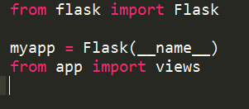
Directories
Main application directory where the app server runs
__init.py__
Package / initialization

Slide 22
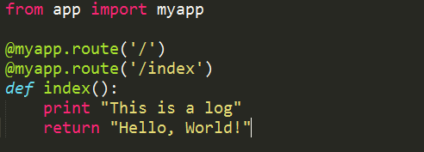
Directories
Main application directory where the app server runs
Views.py - routing

Slide 23
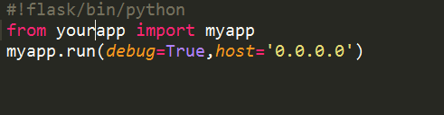
Directories
Outside directory which allows web server to talk with it [WSGI]
run.py

Slide 24
Lab!
Build a prototype SurveyMonkey

Slide 25
Today’s Lab – Part 1
Install Flask
sudo pip install flask
If you have Anaconda, you have Flask
create a conda environment

Slide 26
Today’s Lab – Part 2
Basic form submit [personal diary, user registration, survey]
Landing page is a form {name, email, address…etc.}
User submits > Save data to a text file(CSV)
Bonus creds : Try writing to an Excel ☺
Notes:
https://docs.python.org/2/tutorial/inputoutput.html#reading-and-writing-files

Slide 27
Requests
GET, POST
GET requests have data in the URL
POST Requests have data hidden in the object
http://newCitibank.com/getaccount?username=berkeley&password=littlestbear

Slide 28
Requests
Server side
Request.args.get

